Slide 1
Water …
A Consistent Dividing Line
1 Peter 3:20-21

Slide 2
Importance Of Dividing Lines
City Limits.
State Limits.
County Lines.
Country Lines.
National Lines.

Slide 3
Noah And The Flood
Before
After
Genesis 6,7,8 FLOOD Man’s wickedness / Perished
Noah “saved by water”
1 Peter 3:20-21

Slide 4
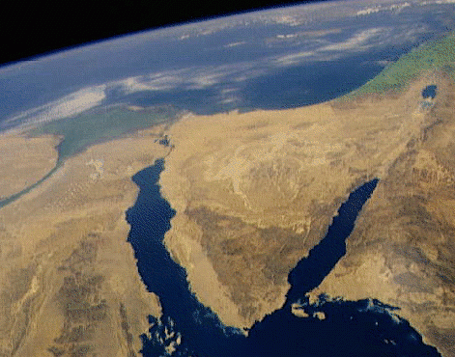
Great Sea
(Mediterranean)
Before
After
Canaan
1 Corinthians 10 Baptized unto Moses
Bondage.
Romans 6:16-18 Freedom.
Baptized unto Christ
Nile
Delta
Sinai
Peninsula
Exodus 15:13
Baptized into Christ
Romans 6:3-4
Egypt
Traditional
Route of
the Exodus
Mt. Sinai
NASA Photo
© EBibleTeacher.com
Red Sea
www.Studylight.org

Slide 5
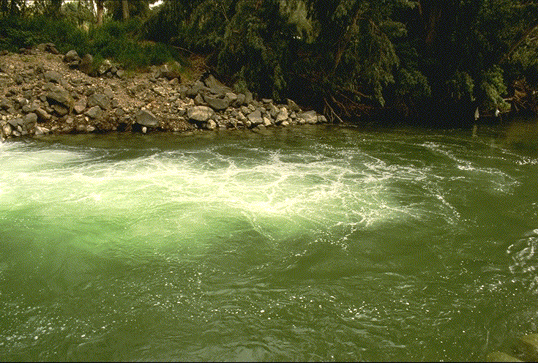
Naaman – 2 Kings 5:1-14
Before
After
Leper
“Wash and be clean …”
Verse 13
Naaman was wroth. Verse 11
“I thought.” Verse 11
Abana and Pharpar.
Verse 12
… Flesh came again … He was clean …” verse 14
(cf. Luke 4:27)
Blessed at obedience.
Dipped 7 times

Slide 6
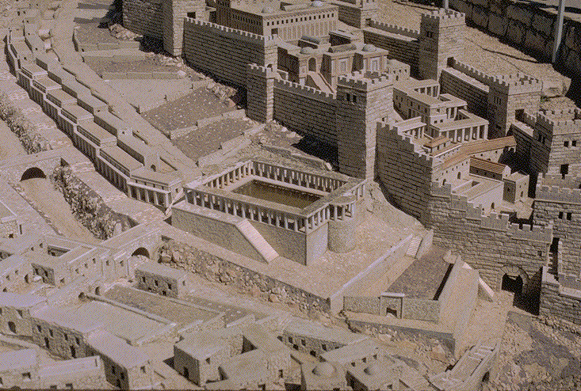
Blind Man John 9:1-7
Before
After
Blind
“Go and wash”
“Washed and came seeing …”
Blessed at obedience.
cf. 2 Corinthians 4:4;
2 Thessalonians 2:10

Slide 7

Mark 16:15-16
15 And he said unto them, Go ye into all the world, and preach the gospel to the whole creation.
16 He that believeth and is baptized shall be saved; but he that disbelieveth shall be condemned.

Slide 8
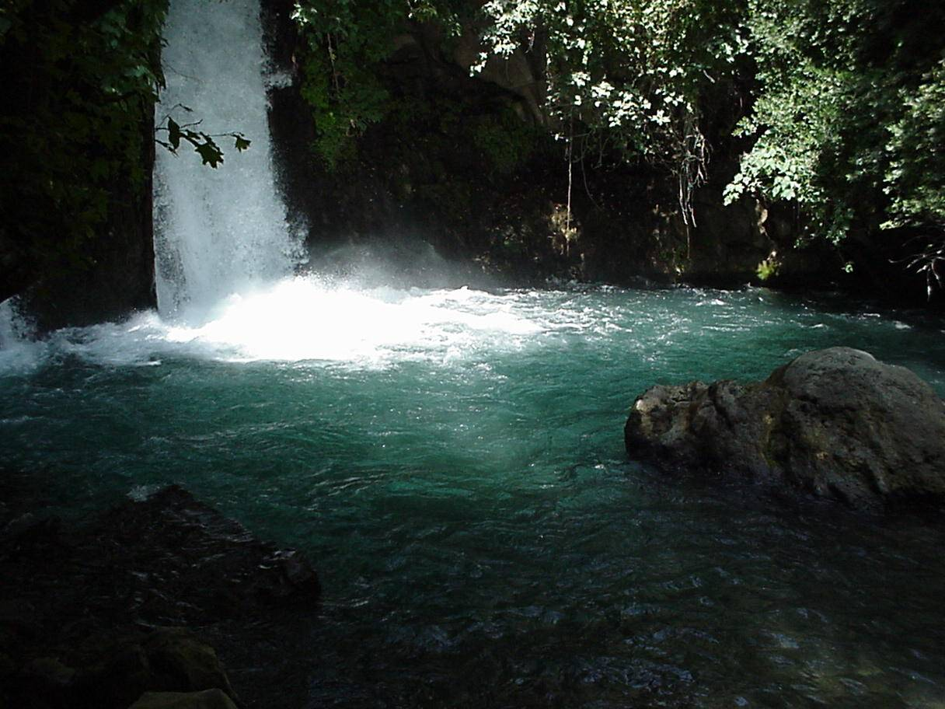
Before
After
Lost in sin.
1 Peter 3:21;
Romans 6:23
Dead in sin.
Ephesians 2:1ff
Separated from God. Isaiah 59:1-2
No hope.
Ephesians 2:12;
1 Thessalonians 4:13
Kingdom of darkness.
Colossians 1:13
Must prepare.
  Taught.
  Matthew 28:19
  Believe. Mark 16:16
  Repent. Acts 2:38
  Confess. Acts 8:37
B
A
P
T
I
S
M
Sin washed away.
Acts 22:16
Alive “with Christ.” Ephesians 2:5
United “in Christ.” Galatians 3:26-27; Romans 6:3-5
In the church.
1 Corinthians 12:13;
In the kingdom.
John 3:5; Colossians 1:13
Redeemed “in Christ.” Colossians 1:14
Hope of heaven.
Colossians 1:5;
1 Corinthians 15:19; Hebrews 6:19

Slide 9

Examples of Conversion
Matthew. 28:18-20; Mark 16:15-16; Luke 24:44-47
Preaching Believed Repented Confessed Baptized Saved
Pentecost Acts 2:14-41 |  | Repented 37-38 |  | Baptized 38-41 | Remission of sins 38-47
Samaria Acts 8:5-13 | Believed 12 |  |  | Baptized 12-13
Eunuch Acts 8:35-39 | Believed 36-37 |  | Confessed 37 | Baptized 38 | Rejoiced 39
Saul Acts 9:17-19; 22; 26 |  |  |  | Baptized Acts 22:16; 9:18 | Washed sins away Acts 22:16
Cornelius Acts 10:34-46; 11:14; 15:7 | Believed 10:43; 15:7 |  |  | Baptized 10:48 | Remission of sins 10:43
Lydia Acts 16:13 | Attended 14 |  |  | Baptized 15
Jailor Acts 16:32 | Believed 31 | Repented 33 |  | Baptized 33
Preaching Faith Repentance Confession Baptism Salvation
Romans 10:4; Hebrews11:6; Luke 13:3; Romans 10:10; Galatians 3:16-27;
2 Timothy 2:10; Hebrews 5:8-9

Slide 10
Baptism
For Salvation – Mark 16:16
Now Saves Us – 1 Peter 3:21
Into Christ’s Death – Romans 6:3
For Remission Of Sins – Acts 2:38
For Washing Away Sin – Acts 22:16
Body Of Sin Done Away – Romans 6:6
To Be Born Again – John 3:5

Slide 11
Characteristics of N.T. Baptism
Puts One Into Christ
  Galatians 3:27, “For as many of you as were baptized into Christ did put on Christ.”
Adds One To Christ’s Church
  Acts 2:47, “praising God, and having favor with all the people. And the Lord added to them day by day those that were saved.”
WHO WERE ADDED?
WHO WERE SAVED?
Acts 2:41
“They then that received his word were baptized: and there were added (unto them) in that day about three thousand souls.”

Slide 12
1 Peter 3:21, “The like figure whereunto even baptism doth also now save us …” KJV
From The Old To The New
The Dividing Line Is Consistent
“Eight souls saved
by water”
Old
World
New
World
Old
Life
(sin)
“Baptism doth also now save us”
New
Life
(saved)

